Slide 1

Handwritten Digit Recognition System using Convolutional Neural Network
Presented By: Sayan Mondal, Chandan Mondal, Rahul Basak, Sayantan Sardar.
Date: 10.08.2023

Slide 2

Overview
Handwritten digit recognition is the ability of a computer to identify handwritten numbers and convert them into digital format.
To achieve this, computer systems use machine learning algorithms like convolutional neural network which are trained on large datasets of labeled examples. These algorithms analyze the structure of each digit to identify its unique features and use this information to classify them.

Slide 3

Problem Statement
The problem addressed in our project is the accurate recognition of handwritten digits.
Handwriting includes significant variations in style, shape and size. Traditional methods often struggle to handle these variations leading to suboptimal results and limited applicability.

Slide 4

Challenges
One of the biggest challenge in handwritten digit recognition is dealing with variations in writing styles. People have different ways of writing the same digit, this can make it difficult for a model to accurately identify them.
Another Challenge is dealing with noise in the data, digits can be incomplete, overlapped and this affects the accuracy of the model.

Slide 5

Applications & Impact
Handwritten digit recognition has variety of potential applications from finance to form processing to postal automation.
In the banking industry where cheque and other financial documents often require manual processing, with this system they can automate this process which will save time and reduce errors.
In postal services accurately recognizing zip codes, tracking numbers can enhance the speed and accuracy of the process.

Slide 6

Methodology
Methodologies we followed -
Dataset preprocessing
A convolutional neural networks including multiple layers such as convolutional layers, pooling layers and fully connected layers.
Trained the CNN model using preprocessed dataset.
Evaluated the performance of the trained model using various metrics.
To optimize the performance we performed hyperparameter tuning.
Analyzed the model’s performance and accuracy using the test dataset.

Slide 7
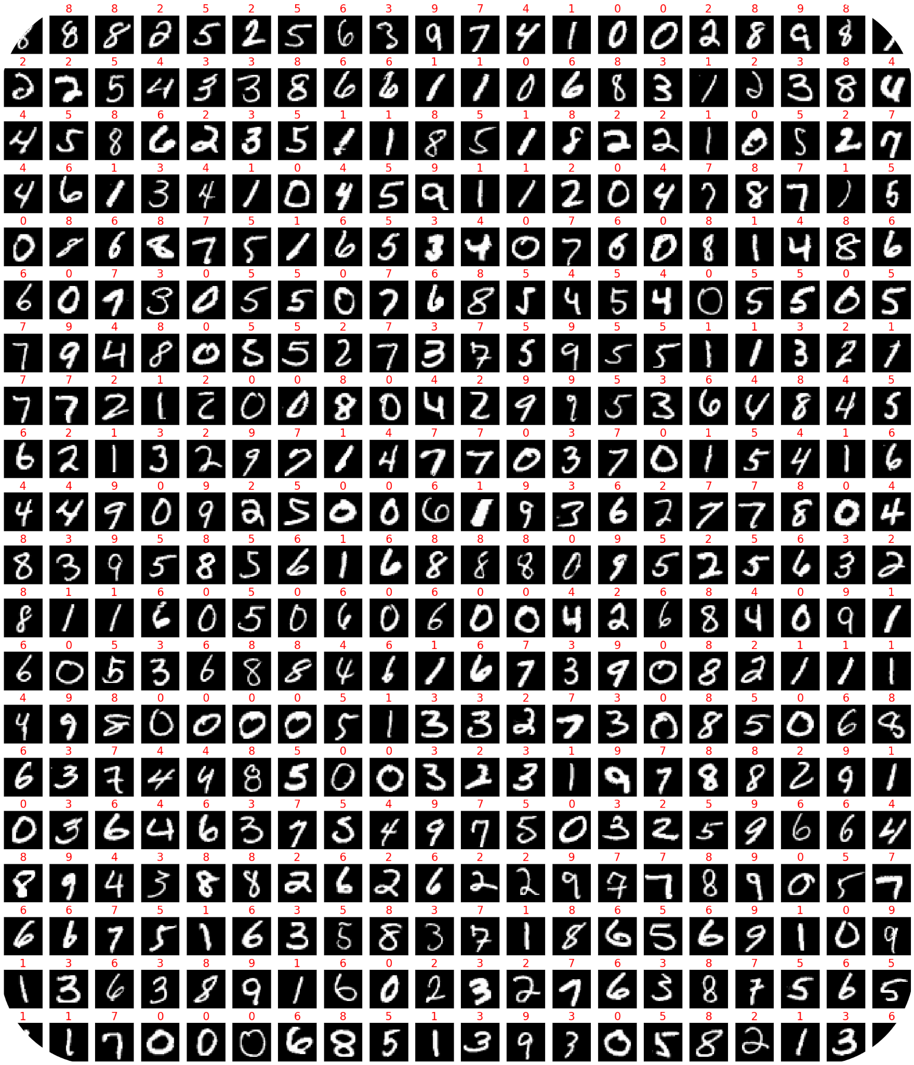
Dataset & Preprocessing
The dataset used in this project is the MNIST dataset, which consists of 70,000 images of handwritten digits which is splitted into 60,000 training and 10,000 testing examples.
Preprocessing -
Normalized the pixel values of grayscale images between 0 and 1.
Images were resized to 28*28 pixels to ensure consistency across the dataset.
After preprocessing, dataset were divided into train and test sets.

Slide 8

Model Architecture
A Convolutional Neural Network (CNN) is a type of artificial neural network that is commonly used in image recognition tasks, such as handwritten digit recognition.
CNNs consist of multiple layers including convolutional, pooling and fully connected.
The convolutional layers are responsible for detecting features in input images, the pooling layers reduce the dimensionality of the feature maps and fully connected layers classify the input image based on detected features.

Slide 9
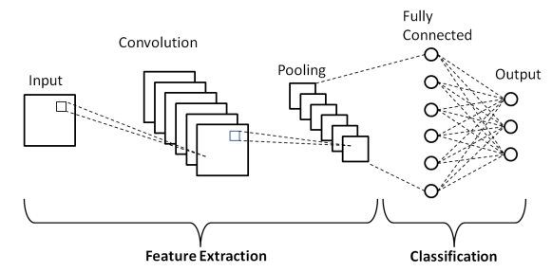
Model Architecture Diagram
Image source: ResearchGate

Slide 10

Model Training & Evaluation
The training process involved iteratively updating the model’s weights and biases to minimize the loss function.
We utilized an optimizer, stochastic gradient descent to efficiently update the model parameters.
To handle large datasets we employed mini-batch training where the training data is divided into smaller batches.
We evaluated the model using training dataset. We computed evaluation metrics accuracy, precision, recall to assess model’s ability.

Slide 11
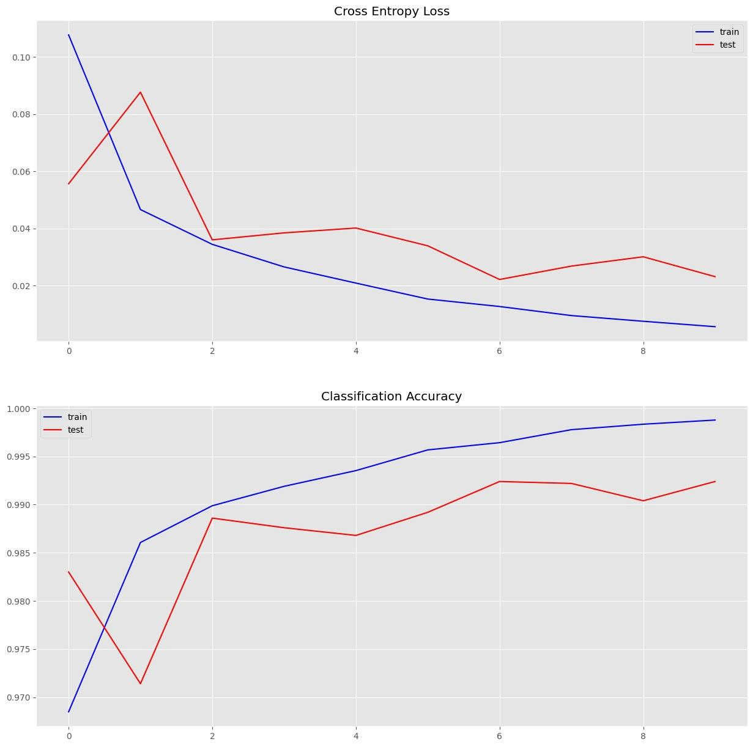
Evaluation Graph

Slide 12
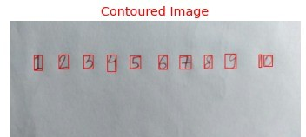

Results and Analysis
Set 1:
Input
Output

Slide 13
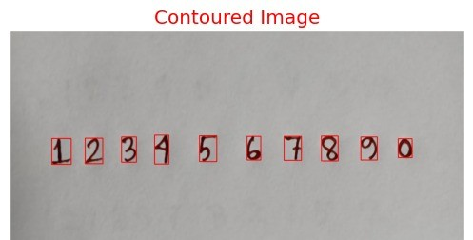
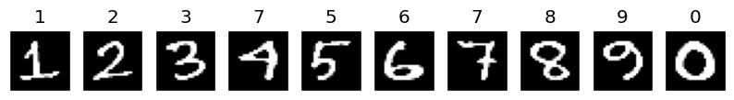
Results and Analysis
Set 2:
Input
Output

Slide 14
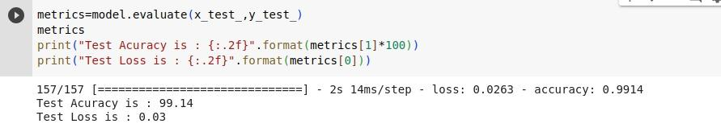
Results and Analysis
Upon training and fine-tuning our model using the established methodology, we proceeded to evaluate its performance rigorously. The following analysis unveils the test accuracy results, a critical measure that gauges the model's ability to generalize its learnings to previously unseen data.
Accuracy -

Slide 15
Conclusion and Future Work
In conclusion, our project focused on the development of a Handwritten Digit Recognition System using Convolutional Neural Networks (CNNs). Through careful dataset selection, preprocessing, model training, and evaluation, we have successfully built a system that can accurately identify and classify handwritten digits with high precision and efficiency.
Looking ahead, there are opportunities for further improvements and research in this field. Exploring larger datasets, refining preprocessing techniques, optimizing model architectures, and exploring more advanced deep learning approaches can enhance the system's capabilities and extend its applications.

Slide 16
Acknowledgement
We would like to Express our special thanks of gratitude to our computer science professor Mr. Probir Mondal for giving us this opportunity and for guiding us to make and fulfill this project.
I would also like to extend my gratitude to my team members for their valuable contribution and enormous support in this project.
Resources Used: Google Slide , Diagrams.net , OpenAi GPT 3.5, Google Docs, Colaboratory
Bing AI Image Creator

Slide 17
Queries

Slide 18
Thank You

